Slide 1
Theme: Innovative Packaging & Decentralized Food Processing
Objective: Build a scalable ready-to-cook ecosystem that reduces prep time and food waste
Hackathon Goal: Demonstrate a technically feasible pilot model for urban food convenience
VIKRAM T
M.E – PRODUCT DESIGN AND DEVELOPMENT,
ANNA UNIVERSITY CHENNAI.

Slide 2
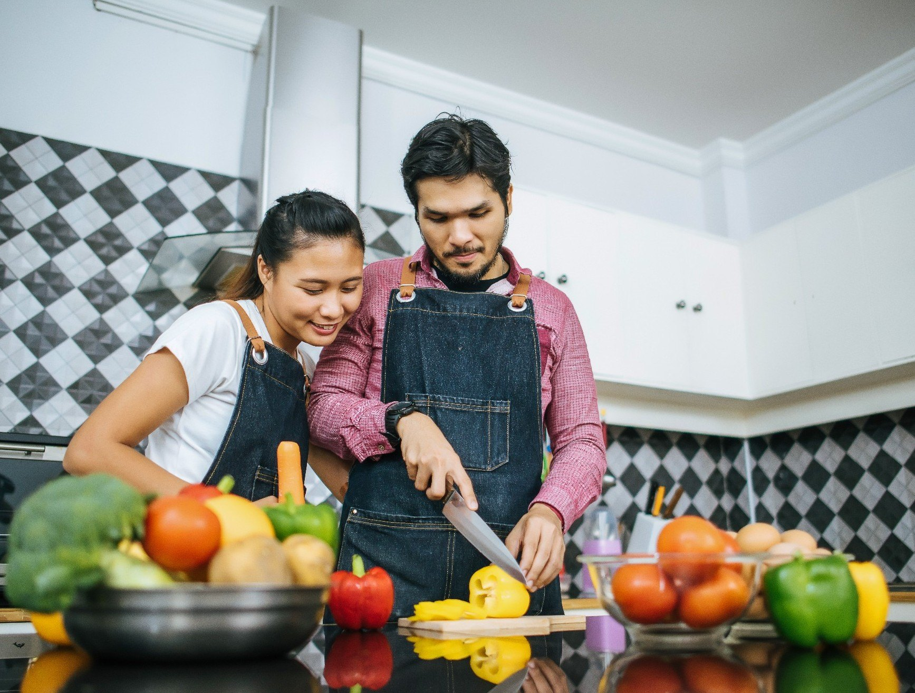
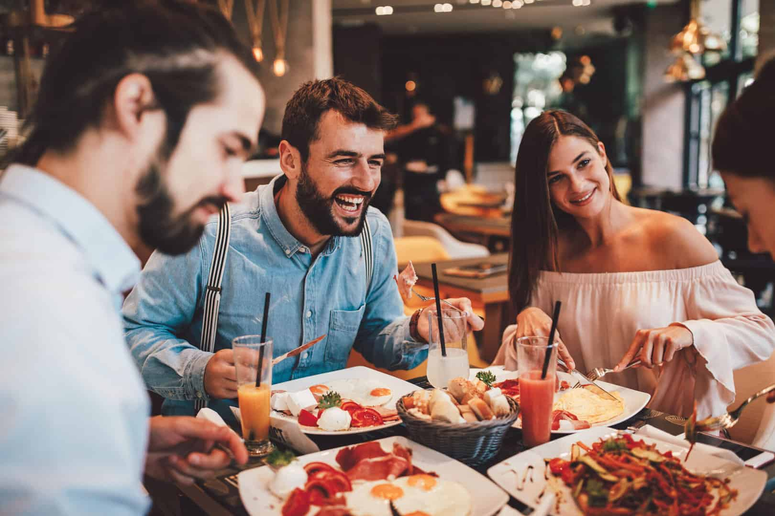
Problem Statement
Urban consumers lack time for fresh cooking; reliance on unhealthy processed foods is increasing.
Conventional pre-cut vegetables have short shelf life and hygiene concerns.
Inefficient packaging causes high food wastage and inconsistent portioning.
Small food processors lack access to standardized preservation technology.
Growing demand for safe, convenient, and sustainable ready-to-cook solutions.

Slide 3
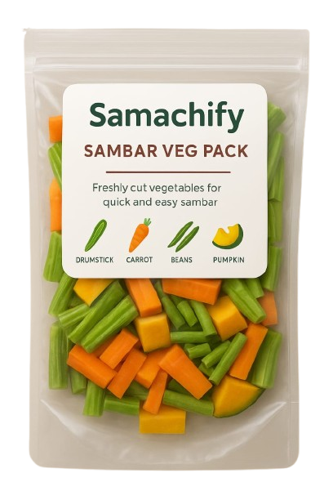
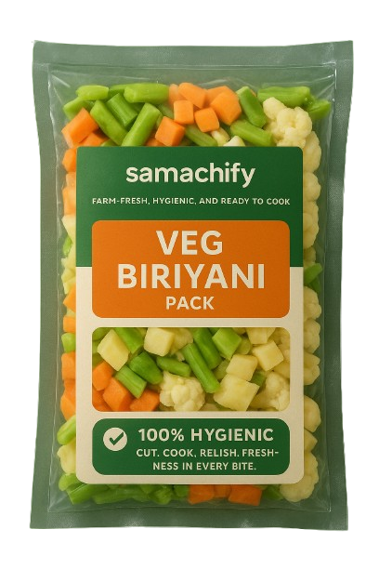
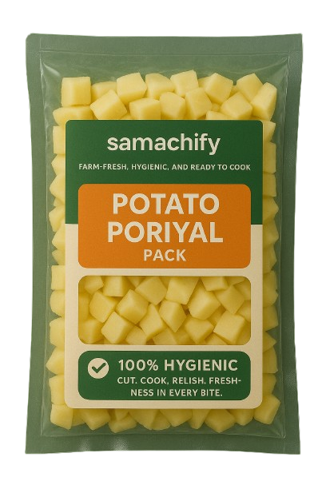
Proposed Solution / Technology
Ready-to-cook meal kits using optimized preservation and smart packaging.
Hygienic processing workflow with cold-chain handling.
Shelf-life extension through improved sealing and controlled storage.
Modular decentralized processing model for local production.
Data-driven portion control to minimize waste and improve efficiency.

Slide 4
Feasibility & Expected Impact
Shelf-life testing completed to validate packaging performance.
Prototype workflow designed for small-scale pilot production.
Reduces cooking preparation time by ~70–80%.
Minimizes household and supply-chain food waste.
Scalable model suitable for urban and semi-urban markets.

Slide 5
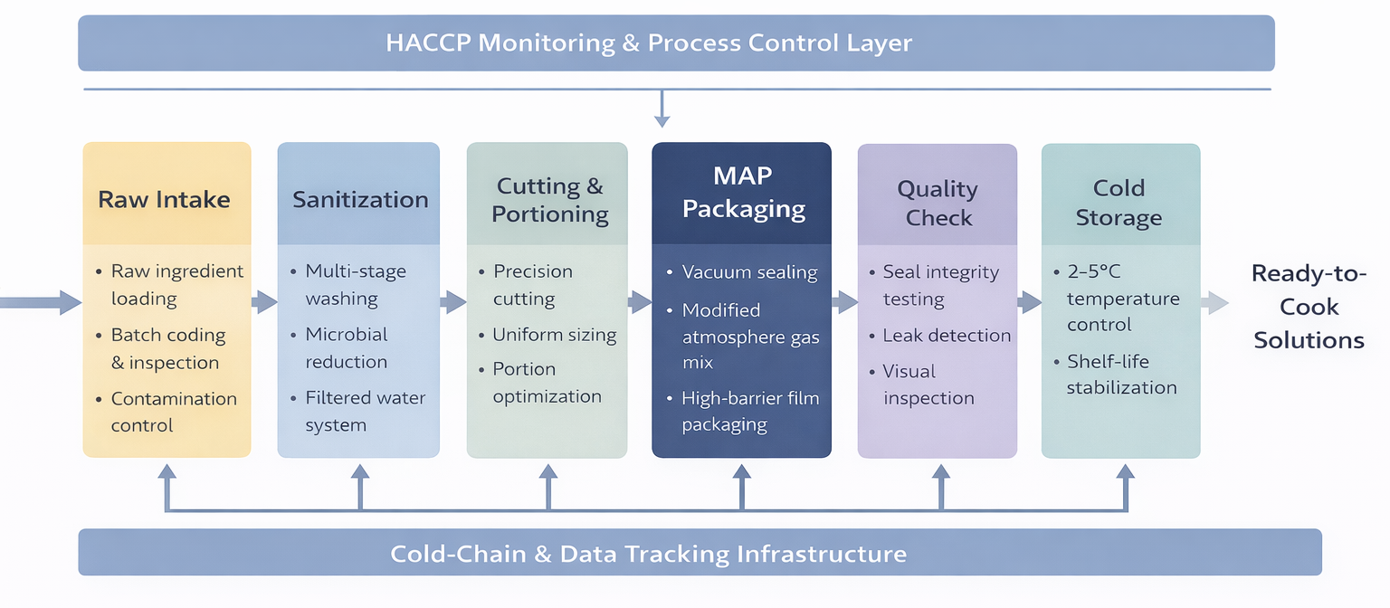
Feasibility & Expected Impact

Slide 6
Implementation Approach & Future Scope
Phase 1: Product formulation and pilot production testing.
Phase 2: Limited D2C launch and customer validation.
Phase 3: Scale decentralized production units and retail partnerships.
Future scope: Automation integration and smart freshness tracking.
Long-term vision: Sustainable, tech-enabled food processing ecosystem.

